Slide 1
Design-Thinking
By –Ameya Mithagari (07)

Slide 2
Background
Talk about the business catchwords and one label that wins the tag war is ‘Creative’.
Every company wants to ride high in this race of creativity and user with their idea of innovation.
The slogan ‘innovate or die’ stands true to its words as brands can only survive in the market if they are constantly innovating and offering something new on the platter with time.
To delve more in this phenomenon of creativity, we must understand the dynamic concept of ‘design thinking’ that fully caters to the user-oriented, prototype-centered process of innovation ideally suited for product, service and business design

Slide 3
What is design thinking?
Design thinking is a systematic approach to handling problems and generating new opportunities.
The concept is pertinent to any field and purpose. If we want to build a new product or customer experience or even take the business to the next level, this approach touches everywhere.

Slide 4
Design vs Design Thinking
The design is not all about looks.
People are restricted to this façade of appearance and blinded with the illusion of visual appeal. Unfortunately, that is not all.
The design is about crafting something new and shelling out a form through expertise so as to provide interactive solutions for complex situations.
Design thinking brings forth a systematic framework for implementing innovation that fosters organic growth and serves real value to the clients. Creativity is the focal point in any design process.
The design thinking stages include observation to learn about the left out needs in relation to the context and constraints of a typical situation, discovering the opportunity and the capacity of innovation, forming brilliant ideas, testing and improving

Slide 5
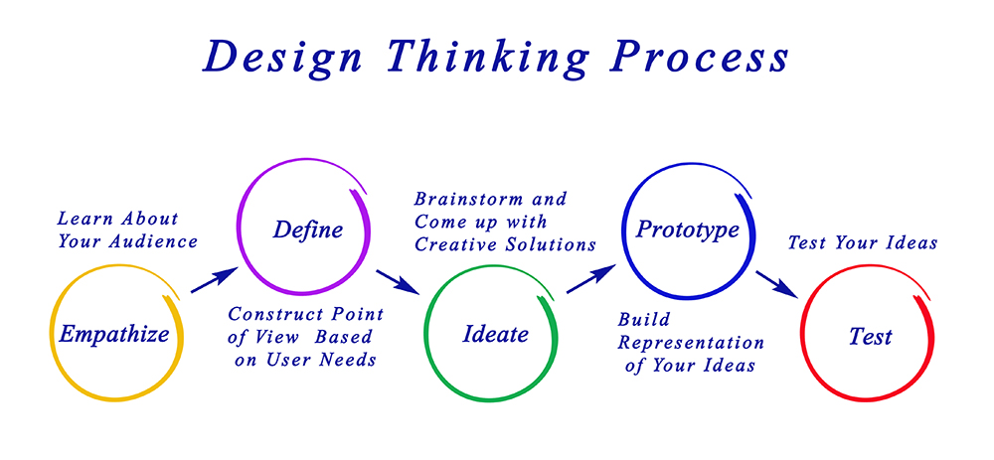
in a way it makes the best practices of agile development, iterative development, user experience, creativity, prototyping and testing shine. It enforces a framework to deal with problems and stimulate innovation

Slide 6
Empathize
Empathizing is central to the design thinking process.
It highlights the significance of listening to the requirements and wants of our customers relative to the particular problem.
The approach aids us in saving our discoveries and learnings during this stage in a systematic way.

Slide 7
Define
Here we combine all the insights collected at the time of listening and observing people.
We start to synthesize and face the challenge ahead of us. That means we start to define a problem.
An aspect that design thinking proves vital at is framing a problem in a clear manner so that we end up devising solutions and exploring opportunities.
Try framing the problem correct so that more avenues and solutions open up.

Slide 8
Ideate
So, now as the problem or the opportunity is clearly framed, we can search for methods to handle it.
We should spur as many ideas as possible. Yes, we brainstorm or ideate.
Design thinking stresses that during this phase we shouldn’t ignore ideas that seem obvious or easy. Any idea can sprout a brilliant concept. So, make sure to look into each and very idea with a fresh mindset.
Design thinking even encourages a team approach to brainstorming and very rightly promotes multi-disciplinary teams that bring across varied outlooks. This definitely produces better outcomes. To finalize this stage, we shortlist the best and leave the rest.

Slide 9
Prototype
Prototyping brings the solutions into vision. Different methods are involved in it such as sketching, rapid prototyping and many others.
No matter whatever method you opt, the core purpose of this stage remains the same, that is, we intend to create rough drafts of solutions to decide if these will prove beneficial for the problem.
As advised, follow a simple, speedy and economical approach while prototyping. Looking onto its context, a prototype can later transform into a beta product or a minimal viable product (MVP).

Slide 10
Test
In this stage, we test our prototype with the customers so as to monitor the response and deem whether the solution satisfied them or not.

Slide 11
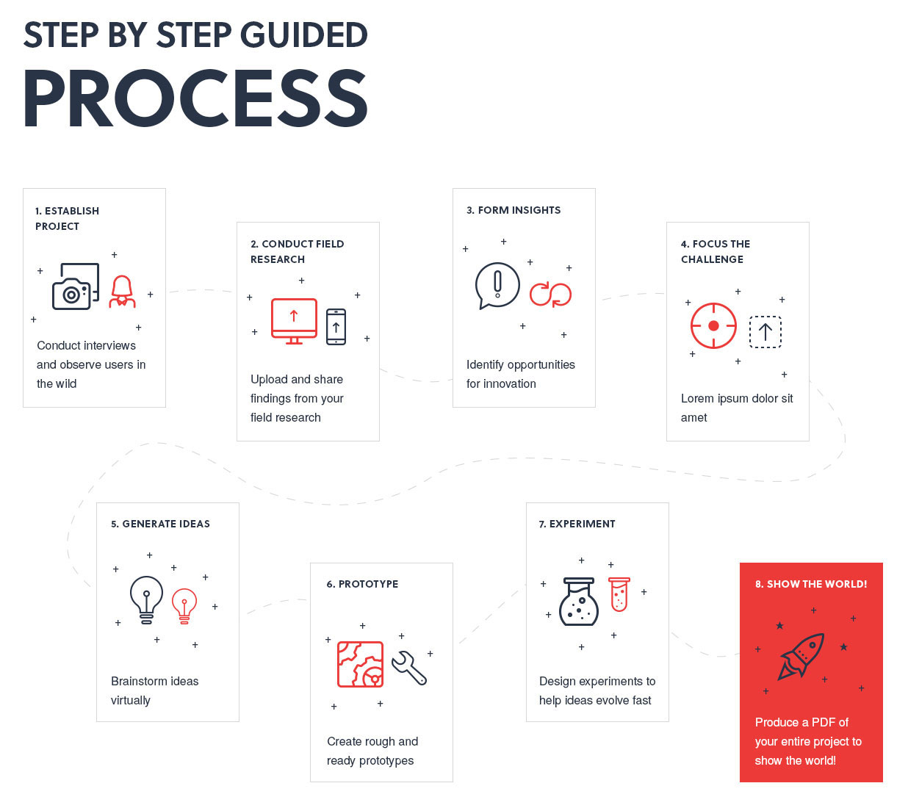

Slide 12
Conclusion
Design thinking is an intricate, proven and rational approach to a new product design that should be given a thought during the product framework in an organization.
Of course, it can’t happen overnight or emerge unless there is someone who adheres to the concept. But it is highly recommended for the companies who are keen on establishing a more interactive and holistic approach to design.

Slide 13
Thank you

